Slide 1
Command Indoctrination
Operations Security
DD MMM YY
Notes:
This is a generic command indoctrination, or on-boarding brief designed for every new member reporting to an organization.
This brief should be tailored to meet specific needs and objectives based on the organizations operations and location.
Per SECNAVINST 3070.2A, Naval OPSEC, both critical information and command most realistic threat (adversary) should be briefed to each newly arrived person, and potentially annually, although annual training should be more extensive.
There are bumper stickers highlighted in YELLOW for the OPSEC Officer or Coordinators to provide the command’s critical information, realistic adversary collection methods and a few other that should be covered in order to meet annual training requirements per SECNAVINST.
Insert command information on this opening slide.

Slide 2
Overview
References
OPSEC process and definition
Critical Information
Operational Aspects of Operations
Personal Information
OPSEC Indicators
Threat
Vulnerabilities
Risk
Countermeasures
Periodic Assessment
Command Working Group
Command and Navy OPSEC Support Team contact information

Slide 3
References
National Security Presidential Memorandum (NSPM-28), 13 January 2021
National Operations Security Program
Department of Defense Instruction (DoDI) 8170.01, 2 January 2019, Online Information Management and Electronic Messaging
SECNAVINST 5720.44C W/CH-2, 21 February 2012, DON Public Affairs Policy and Regulations
SECNAVINST 3070.2A, 9 May 2019, Operations Security
NTTP 3-13.3, December 2022, Operations Security
Navy Social Media Handbook (2023)
Notes:
Department of Defense Instruction (DoDI) 8170.01, 2 January 2019, Online Information Management and Electronic Messaging
Covers use of social media platforms, Applications and most on-line systems
SECNAVINST 3070.2A, 9 May 2019, Operations Security
NTTP 3-13.3M / MCTP 3-32B, September 2017, Operations Security
SECNAVINST 5720.44C W/CH-2, 21 February 2012, DON Public Affairs Policy and Regulations
Navy Social Media Handbook (2019)

Slide 4
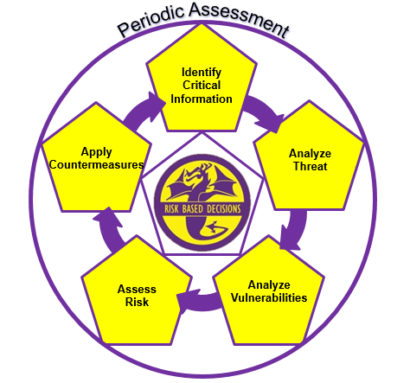
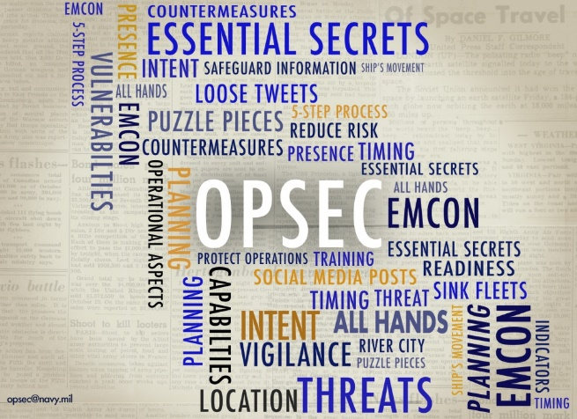
Operations Security
Operations Security (OPSEC) is a process designed to identify, protect and control unclassified critical information and indicators (CII) from adversary exploitation.
Analyzes potential adversaries (threats) from whom to protect your critical information.
Determines where our information is most vulnerable to adversary exploitation – how are they collecting?
Enables Commander’s to make operational risk-based decisions as well as employ OPSEC countermeasures to protect critical information.
Notes:
Operations Security:
A systematic, proven cycle by which a government, organization, or individual can identify, control, and protect generally unclassified information about an operation/activity and, thus, deny or mitigate an adversary's/competitor's ability to compromise or interrupt said operation/activity.
OPSEC is a cycle of identifying critical information and subsequently analyzing friendly actions attendant to military operations and other activities to (a) identify those actions that can be observed by adversary intelligence systems, (b) determine indicators adversary intelligence systems might obtain that could be interpreted or pieced together to derive critical information in time to be useful to adversaries, and select and execute measures that eliminate or reduce to an acceptable level the vulnerabilities of friendly actions to adversary exploitation
Operations Security Cycle: An analytical process that involves five components: identification of critical information, analysis of threats, analysis of vulnerabilities, assessment of risks, application of appropriate countermeasures and periodic assessment of effectivness
Remind people that OPSEC is much like Operational Risk Management (ORM) or Safety. The process is very similar, but deals with information.

Slide 5
Operational Aspects of Operations
Any pieces of information that relate to, or derive from the command’s operational aspects of military operations:
  Presence: Where your unit is currently located
  Capability: The unique abilities your unit lends to the operation
  Strength: The number of units or personnel coupled with the ability to withstand great force
  Intent: What your unit plans to do
  Readiness: Level of preparedness to execute
  Timing: Specific timeliness of events
  Location: Where your unit will deploy (specific locations)
  Method: The way your mission will be executed
Discuss which operational aspects relate to your command and are the most significant?
Notes:
Critical information: Specific facts about friendly (U.S.) intentions, capabilities, or activities vitally needed by adversaries for them to plan and act effectively so as to guarantee failure or unacceptable consequences for accomplishment of friendly objectives.
These are examples of what critical information could be. Discuss how this information can be critical. What can happen if the adversary were to gain knowledge of this information? Can you think of any other information that might be critical?
Critical Information will be derived from the eight operational aspects of operations:
- Presence – where your organization or unit is currently located
- Capability – The unique abilities your unit lends to operations
- Strength – The number of units or personnel coupled with the ability to withstand great force
Intent – What your unit plans to do
Readiness – Level of preparedness to execute
Timing – Specific timelines of events
Location – Where your unit will specifically deploy
Method – The way the mission will be executed
Command OPSEC Officer or Coordinator should discuss which operational aspects relate to your organization, followed by the critical information associated with each OA.

Slide 6
Critical Information
The unclassified Information we must protect to ensure success and is the same information the adversary needs to prevent our success.
Critical information will derive from our operational aspects.
Not all of the operational aspects of military operations will apply to each and every organization.
Per SECNAVINST 3070.2A, the command’s critical information list (CIL) must be discussed during the onboarding process.
  Discuss what is on the CIL
  Provide or show a copy to newly arrived personnel, or
  Let new member know where to locate or find the CIL
Every command member must be familiar with the organizations Critical Information List (CIL) per SECNAVINST
Notes:
Critical information: Specific facts about friendly (U.S.) intentions, capabilities, or activities vitally needed by adversaries for them to plan and act effectively so as to guarantee failure or unacceptable consequences for accomplishment of friendly objectives.
Critical Information will be derived from the eight operational aspects of operations, shown on the next slide. However, the operational aspects are as follows:
- Presence – where your organization or unit is currently located
- Capability – The unique abilities your unit lends to operations
- Strength – The number of units or personnel coupled with the ability to withstand great force
Intent – What your unit plans to do
Readiness – Level of preparedness to execute
Timing – Specific timelines of events
Location – Where your unit will specifically deploy
Method – The way the mission will be executed
Every command must have a CIL. This CIL should be view by the new arrival and also identified where it is located so it can be referred to in the future.
Command OPSEC Officer or Coordinator should brief the CIL here.

Slide 7
Personal Information
By comparison, personal information, although doctrinally not considered “Critical Information”, may lead to your association with the military or military operations, and possibly related to operational aspects
Some examples of unclassified information associated with you and your family, that you may consider protecting include:
  Names, photos and details of you and your children
  Usernames and passwords to all accounts
  Social Security Numbers (always)
  Credit card/banking information (NFCU)
  Significant dates (birthdays, anniversaries)
  Addresses and phone numbers
  Everyday schedules (your routine or predictability)
  Travel itineraries, when you’re away from home
Personal information, when divulged and aggregated on the world wide web, could INDICATE your military affiliation
Notes:
Have you ever heard someone say “that’s an OPSEC violation” or “that’s an OPSEC issue”?
Often times, it may not be an OPSEC related issue or fall within the OPSEC “swim lane”.
OPSEC is an operations function, and unless the disclosure or critical information is derived from the operational aspects, it may fall with one of the security disciplines like information security, personal security, anti-terrorism/force-protection, industrial security etc.
However, disclosing personal information on social media platforms for example, could eventually lead to your association with a command and/or event, and then further lead to the disclosure of critical information when in the aggregate.
Depending on your mission and organization, some personal and personnel information may require a level of protection

Slide 8

Indicators
Friendly, detectable actions that reveal critical information and vulnerabilities
  Longer working hours
  Rehearsals
  Sudden changes in procedures
  On-loads
  Large crew / troop movements
  Emblems/logos
  Routine or predictable patterns
Not all indicators can be completely protected
Not all indicators are necessarily bad
  We may want to project certain information
Notes:
Indicators are friendly detectable actions that reveal critical information, which then leads to vulnerabilities.
Discuss how these things can be an indicator. What could they mean?
For example, let’s say that your unit was all of a sudden working until the middle of the night. What could that possibly mean? Would an adversary want to investigate this further? For example, huge stores on-loads on a pier could indicate a ship getting underway for a major deployment.
Not all indicators are bad. That ADT sign in the front yard indicates a house that is alarmed, whether or not it even works or is actually alarmed. That one indicator could potentially keep a thief (adversary) from hitting your home…….an example of personal indicators.
Discuss what could be good indicators in the military. A large security presence with heavy weapons could indicate that they are guarding something or someone important. The weapons could possibly keep the adversary from trying to access that area.

Slide 9
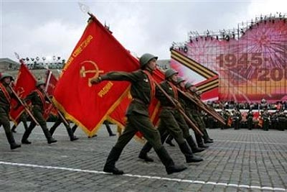
Threat
Intentions and Capabilities of an adversary to undertake any action detrimental to the success of friendly activities or operations.
Conventional Threats
  Military opponents
Unconventional Threats
  Terrorist (foreign and domestic)
  Hackers, Scammers
  Insiders (spies)
  Foreign Intelligence Services
Per SECNAVINST 3070.2A, the command’s most realistic threat must be discussed during the onboarding process.
  Discuss who they are, and how they collect
Discuss your organization’s most realistic threat or adversary per SECNAVINST
Notes:
Adversaries must have both Intent and Capability to be considered a real threat to the U.S. and it’s allies.
We deal with both conventional and unconventional adversaries today, and unfortunately, more and more unconventional adversaries.
The primary threat to the United States today is/are foreign intelligence services (spies trying to gather information). They are very active, especially in the DC metro area and near military bases. Why are they targeting these places?
Threat information can be obtained from either a command’s S2/N2 shop or any local NCIS area office. Much of what NCIS provides in the US is available from the NCIS MTAC site or other on line sites.
Every command member must know and understand their most realistic adversary or threat, specifically how or what methods they employ when collecting command information.
Command OPSEC Officer or Coordinator should brief the commands most realistic threat / adversary here.

Slide 10
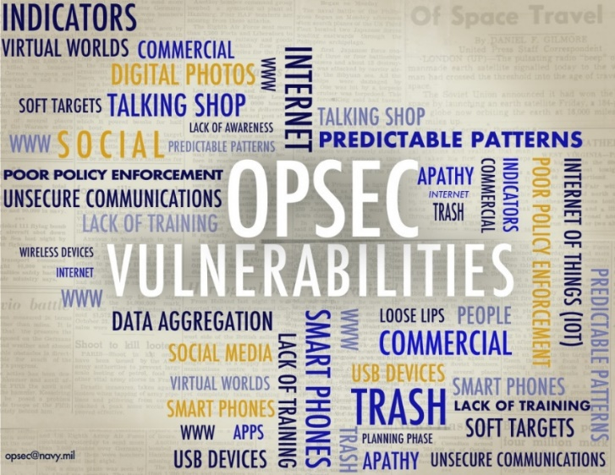
Vulnerabilities
Weakness an adversary will exploit to acquire critical information
Some of the most common vulnerabilities include:
  Lack of awareness (‘I didn’t know’ is not an excuse)
  Apathy (no one cares about me, so what?)
  Social media posts (but it’s private)
  Use of commercial Applications (Apps) for official business
  Social engineering
  Data aggregation from a multitude of sources
  Technology advances daily
  Trash (no one looks through trash any more)
  Poor policy enforcement (why write it?)
  Unsecure communications
  Predictable actions/patterns
The above list is not inclusive
Notes:
Vulnerability: A weakness the adversary can exploit to get critical information. A vulnerability is anything that makes your critical information susceptible to intelligence collection. Discuss how these things are vulnerabilities.
Lack of awareness- Many just are not aware of the vulnerabilities when posting information.
Apathy – Either people just don’t care, or don’t believe they could be a source of information.
Social media- There are billions of users, and none of the sites are 100 percent secure. Essentially, you could be posting information to billions.
Commercial Apps- Just because they are available, does not mean we’re authorized to use them for official navy business. In fact, commercial App are not authorized.
Social engineering- We are naturally friendly and like to talk about our work or personal experiences. Don’t share this information with strangers, regardless of home harmless they may seem.
Understand the aggregation issues and how the internet/world wide web makes it easy.
Technology- For every new gadget that’s developed, you can be sure there is a vulnerability associated with it.
Trash- Be sure to shred/burn all personal of official correspondence, to include junk mail.
Poor policy enforcement- Policies are only as good as how they are enforced. An all shred policy is great as long as everyone participates. No cell phone policy in the spaces for security purposes must be enforced.
Many people think cell phones are secure. Most methods of communications used today are not secure.
Don’t be predictable.

Slide 11

Risk
The probability an adversary will gain knowledge of your Critical Information and the impact if they are successful
Impact: What it will cost YOU if your Critical Information is lost?
  Lives
  Mission
  Money
  Time
How much are you willing to risk by displaying an indicator or not correcting a vulnerability?
Discuss the following per SECNAVINST 3070.2A
Risk and guidance on geo-location devices and applications (Apps)
Review procedures for releasing information to the public
How to protect, transmit, and destroy Controlled Unclassified Information (CUI)
Notes:
Risk is the probability an adversary will gain knowledge of your critical information and the impact it will have on your mission if they are successful. When assessing risk, Commanders must think about how it could impact the lives of personnel, the mission, how much the organizations stands to lose in money, and time lost as a result of the mission being impacted.
Commanders have to decide what level of risk they are willing to accept if their critical information is exploited and acted upon.
Think of risk on the physical world. When you drive a vehicle on a busy and hazardous road, you assume a high level of risk. Taking an alternate route, less traveled reduces you risk of getting into an accident. The same applies to information. Some information is more sensitive to than other information…..and if collected and acted on, could result in catastrophic consequences.
Command OPSEC Officer or Coordinator should brief the commands policy on the below per SECNAVINST 3070.2A in order to meet annual and onboarding requirements.
- Risk and guidance on geo-location devices and applications (Apps)
- Review procedures for releasing information to the public
- How to protect, transmit, and destroy Controlled Unclassified Information (CUI

Slide 12
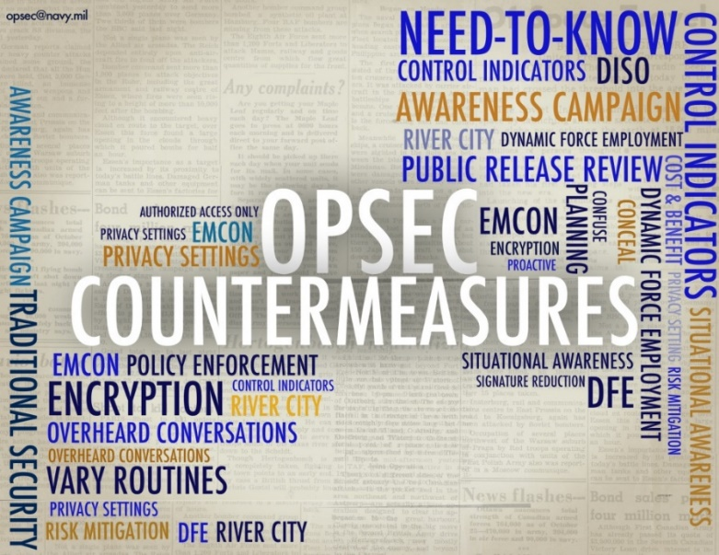
Countermeasures
Anything that effectively negates or reduces an adversary's ability to exploit vulnerabilities or collect & process critical information
  Hide/control indicators
  Vary routes
  Modify everyday schedules
Influence or manipulate an adversary’s perception
  Take no action
  React too late
  Take the wrong action
Notes:
Think back to the list of common vulnerabilities.
For example, lack of awareness. A countermeasure to this vulnerability could be something as simple as training - so personnel now understand what information to protect and how to protect it.
Review the list of common vulnerabilities and discuss the ones most relevant to your command/organization. Discuss the measures and countermeasures that can be employed for each vulnerability.
The bottom line is we want to change the adversaries perception of our activity and cause them to react differently; like react too late, take the wrong action or take no action at all.

Slide 13

Periodic Assessment
Requires an evaluation of the command OPSEC posture and its ability to maintain essential secrecy.
  Is conducted to determine if anything has changed in the previous steps, are your countermeasures working as designed based on your MOP(s) and MOE(s), and are the countermeasures still needed.
Example: A new vulnerability has been introduced to the mission. At this point, you will determine if there is a risk to your critical information. If there is a risk, and it is above the acceptable level set by the Commander, then a countermeasure must be implemented.
  In the example; assuming nothing has changed prior to the introduction of the vulnerability, the previous two steps will not need to be addressed.
Notes:
Understanding that OPSEC is a continuous cycle, it only makes sense to assess if we are achieving the end goal of OPSEC. OPSEC is not a one and done cycle. In the words of Albert Einstein “Insanity is doing the same thing over and over again and expecting a different result”. This is why we have step six of the OPSEC cycle, to ensure we are adjusting to the information environment and executing OPSEC properly.

Slide 14
Command POCs
OPSEC Officer / Program Manager:
Assistant OPSEC Officer / PM:
Working Group Members
  N1
  N2
  N3
  N4
  N5
  N6
  N7
  N8
  N9
Notes:
Insert all command working group members by department, division, or directorate, depending on how your command is organized.
Every command member should know who the OPSEC Officer and Assistant OPSEC Officer are……and at a minimum, the working group member in their division or department.

Slide 15

Contact Information
Your Logo here
Your Command OPSEC Program Manager information here.
NAVY_OPSEC@us.navy.mil
757-203-3656
NAVAL INFORMATION FORCES
ATTN: NAVAL OPSEC SUPPORT TEAM
115 LAKE VIEW PARKWAY
SUFFOLK, VIRGINIA 23435

